Slide 1


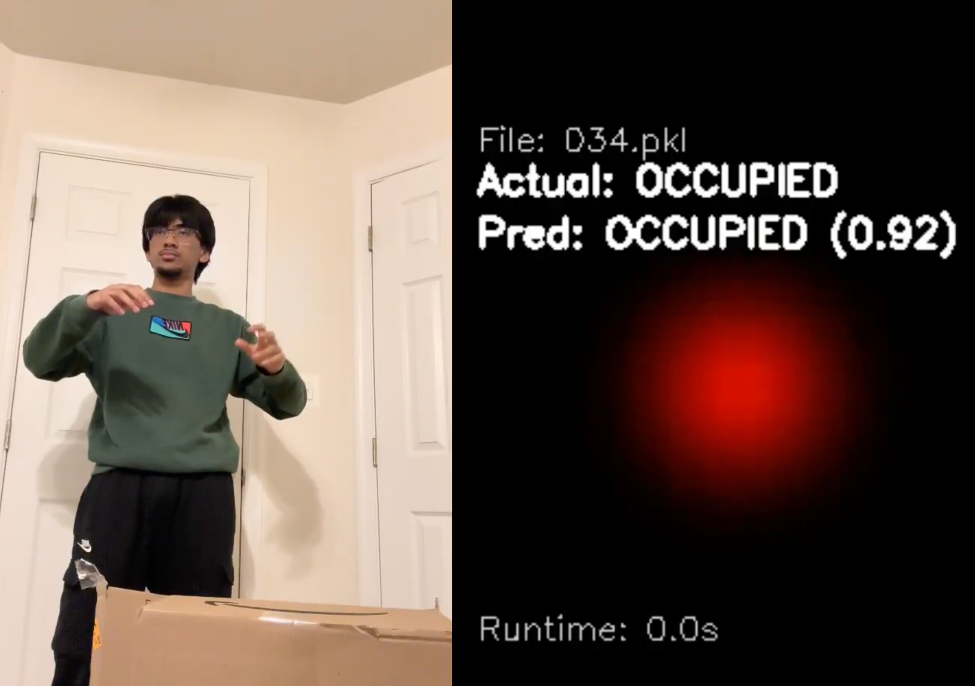
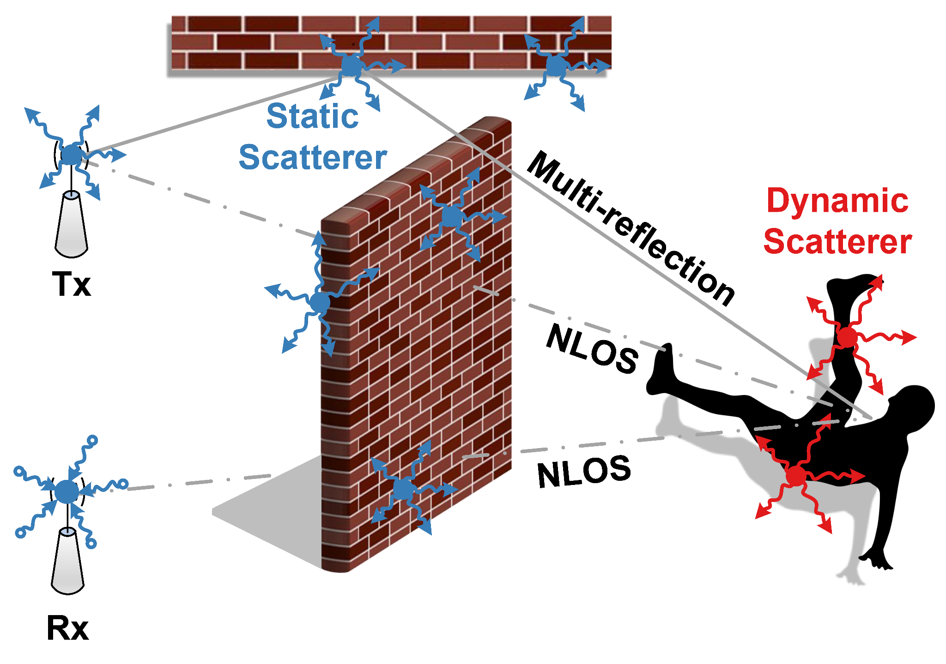
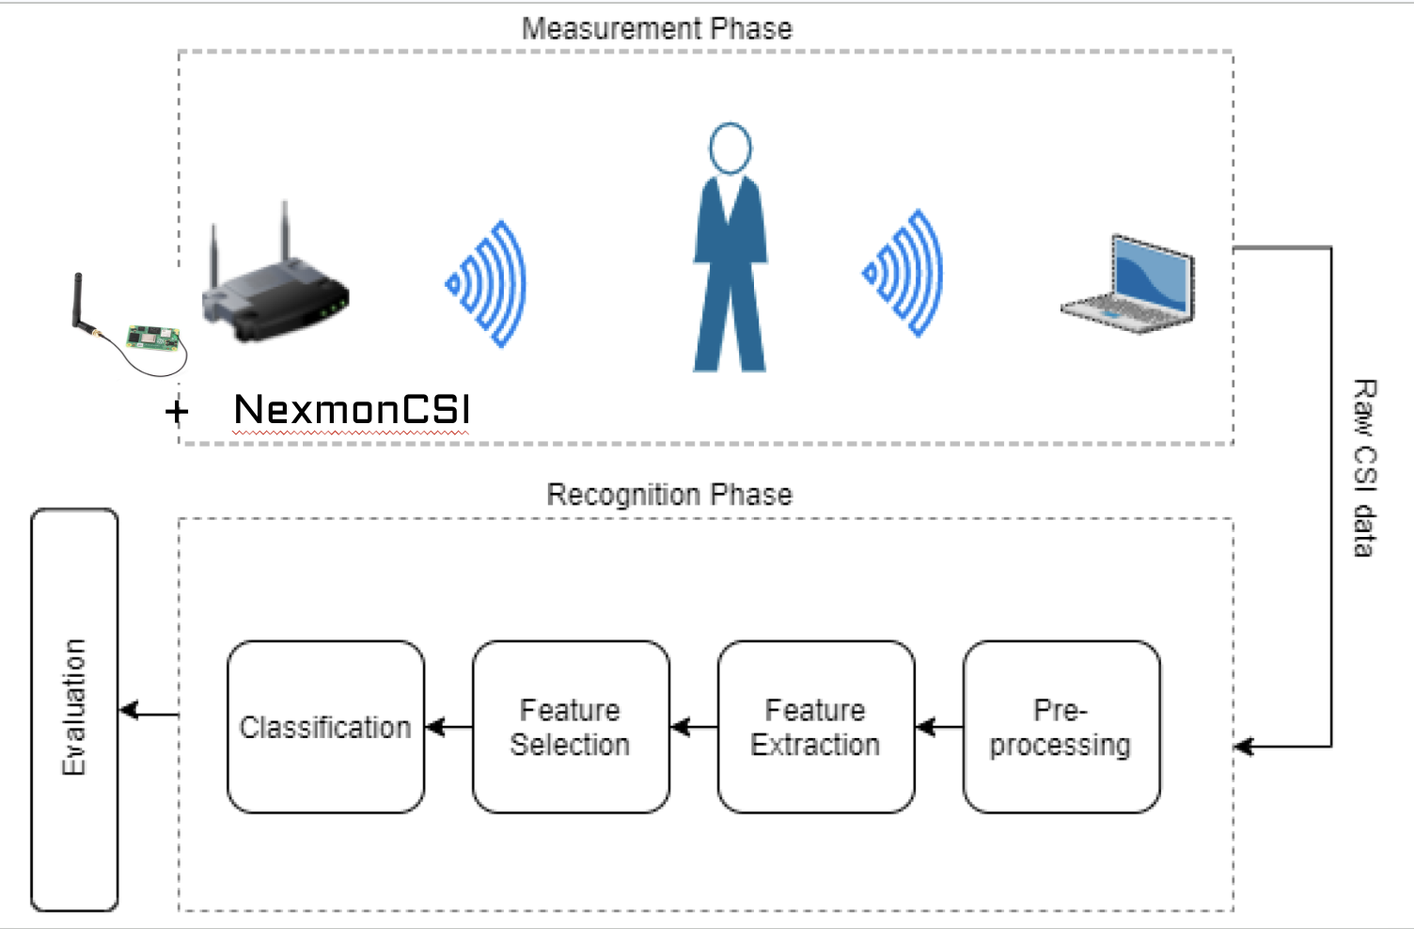
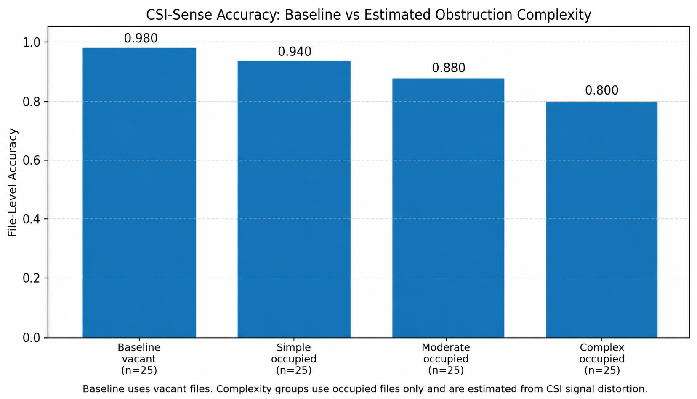
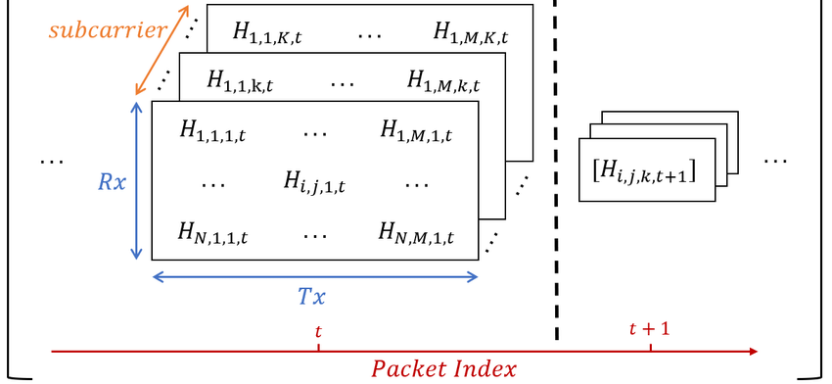
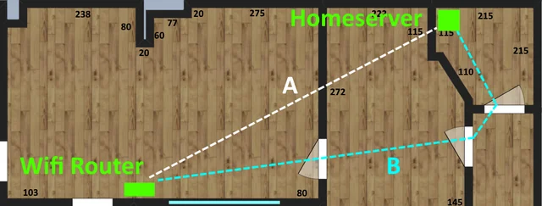
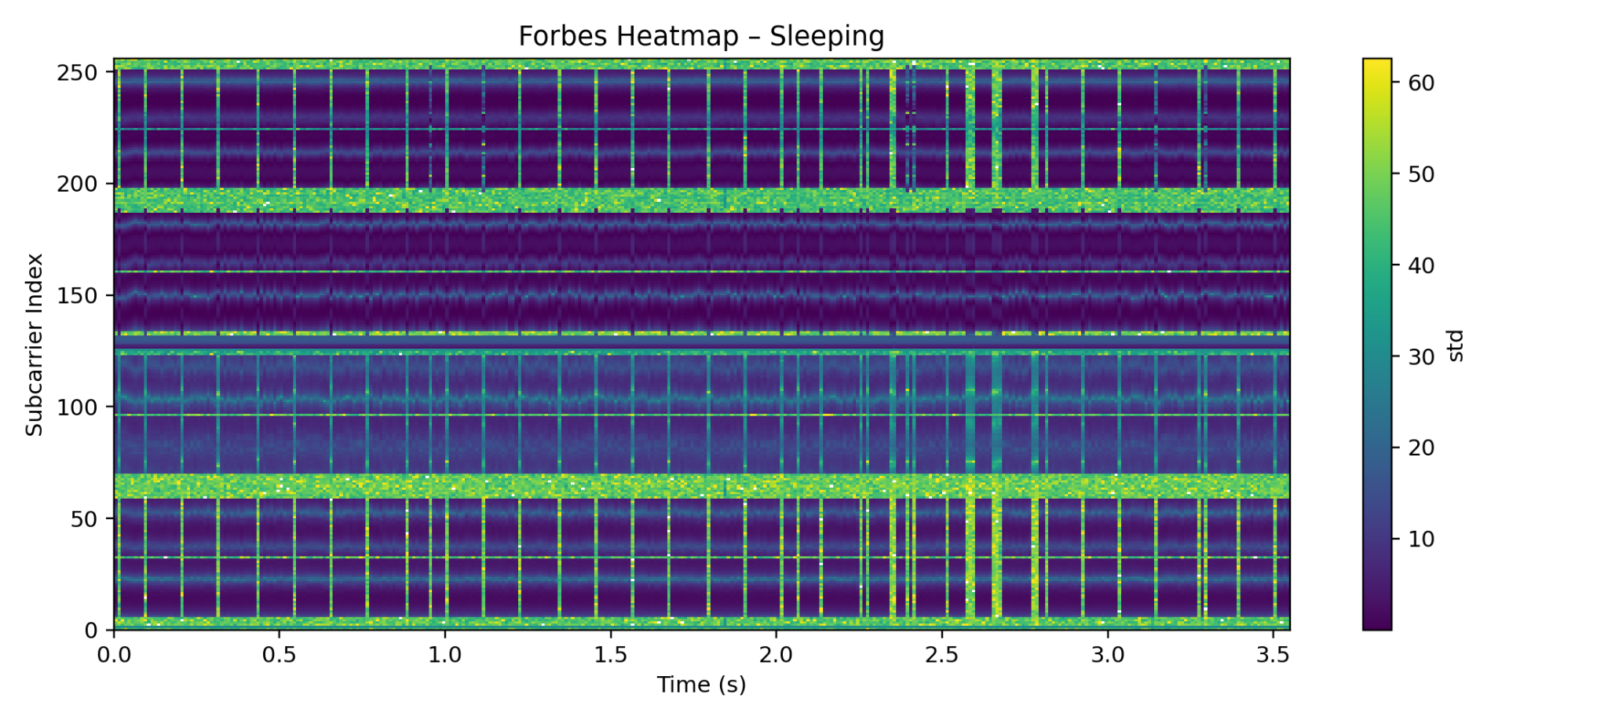
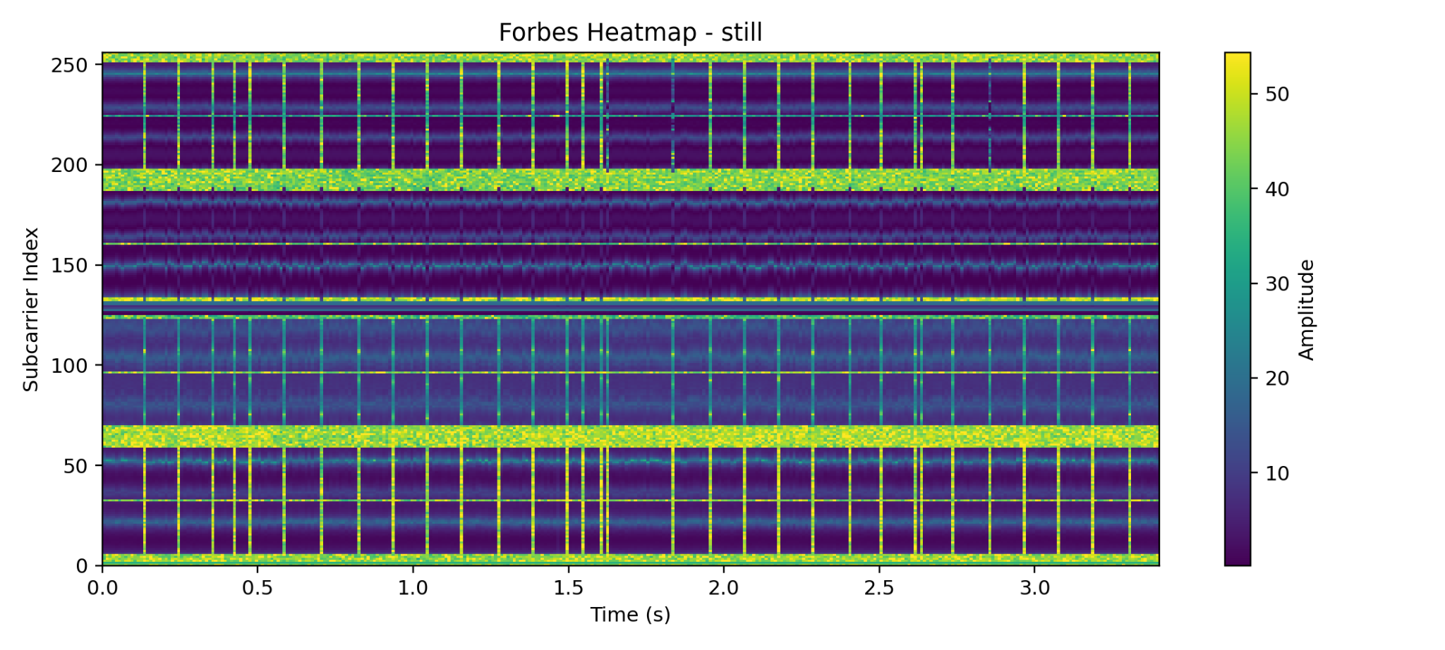
Fabeun Rahman
CSI-Sense
Detecting Presence Behind Obstructions For S.A.R. Using WiFi
Systems Lab
Yilmaz
2026
Demo
Introduction
Many search-and-rescue scenarios involve locating individuals behind walls or debris, where traditional cameras and sensors fail due to lack of visibility. This makes detection slow and difficult in time-critical situations. Using widely available WiFi signals, subtle changes in signal behavior can reveal the presence of a person without requiring direct line of sight. Facing this challenge, we developed a system that uses Channel State Information (CSI) to detect human presence through obstructions. As shown in Fig. 1, the data is formatted as 3-D matrices of amplitude and phase values that can be derived from a “CSI” scalar, which is a complex value represented by H.
Fig. 3: Red intensity blob correlating with motion
Fig. 2: Systems Architecture
Methods
As shown in Fig. 2, our system uses a 2.4 GHz Wi-Fi router, Raspberry Pi, and laptop to detect presence behind obstructions. The router sends Wi-Fi packets while the Raspberry Pi uses Nexmon CSI to record how the signal changes after passing through walls or clutter. Tests are run under simple, moderate, and complex obstruction setups, with both vacant and human-present recordings collected. The CSI data is converted from PCAP files into cleaned .w files, then processed into amplitude-based time windows. Each window is analyzed using STFT to extract low, mid, high-frequency energy, and entropy features. These features are passed into a binary Random Forest classifier, which predicts vacant or occupied and outputs a heatmap video where stronger red intensity represents higher confidence of human presence.
Fig. 4: Accuracy Across Obstruction Complexities
Impact & Future Work
Our system was successfully able to detect human presence behind a door, showing that WiFi CSI can support low-cost NLOS sensing for search-and-rescue applications. However, our testing environment cannot fully replicate the chaos of real disaster scenarios, including multi-layered rubble, unstable structures, and cluttered materials. Future work includes systematically testing RF penetration through different construction materials, thicknesses, and distances, improving direct device-to-device detection rather than Pi-to-laptop processing, and developing a better display system beyond side-by-side video output.
H = a+jb → one “CSI” scalar
|H| = sqrt(a²+b²) → amplitude
θ = atan2(b, a) → phase
Fig. 1: CSI Matrix Visualization and Formulas
Results
Novelty
My system processes WiFi CSI data to estimate whether a person is present behind an obstruction. In testing, it was able to detect presence behind a door, proving that commodity WiFi signals provides useful NLOS sensing. Detection became less reliable with more cluttered environments as seen in Fig 4. The output is visualized through a red intensity overlay, as shown in Fig. 3. As shown in Fig. 5, around subcarrier 110 at 2.35 s, the sleeping condition reaches about 31 compared with about 17 for the empty baseline, indicating that even quiet breathing nearly doubles CSI variability.
No prior low-cost system provides reliable presence detection behind obstructions using only commodity WiFi hardware. My approach is novel because it repurposes CSI from everyday wireless signals instead of relying on cameras or expensive radar systems. While many sensing methods require direct visibility, my system can operate in non-line-of-sight (NLOS) conditions. This a it especially useful for S.A.R. scenarios, where responders need fast, accessible tools to detect whether someone may be behind clutter.
Fig. 5: Heatmap Comparison: Still vs. No presence

